Slide 1
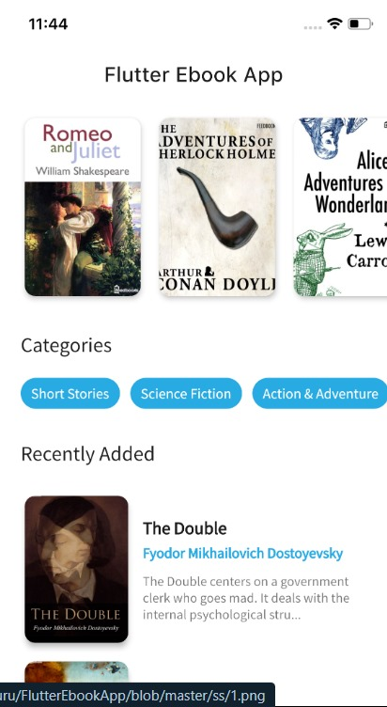

Designing a Flutter E-Reader App
Created by
Harsh 21CSU559
Ayush 21CSU586
Parvinder 21CSU560
Mukesh 21CSU424

Slide 2
Project Scope
Designing and Developing UI
Integrating Ebook Libraries/Services
Implementing Reading Features
The project's primary objective was to create a user-friendly interface for the e-reader app. This involved designing an intuitive and visually appealing UI that supports easy navigation and follows material design principles.
The app aimed to integrate with ebook libraries or services, enabling users to browse and download ebooks directly within the app. This required handling authentication, fetching book metadata, and efficiently managing download queues.
The project focused on implementing customizable reading features such as adjustable font sizes, night mode, and bookmarking to enhance the user's reading experience and navigation within the app.

Slide 3
Technical Implementation
UI Design
Ebook Integration
State Management and Features
The UI design process emphasized creating an intuitive and visually appealing interface for the app, following material design principles for consistency and easy navigation.
The app integrated with ebook libraries or services, allowing users to browse and download ebooks directly within the app. This required efficient handling of APIs and download queues.
State management techniques, such as Provider or Riverpod, were utilized to ensure efficient synchronization of data across different screens, providing a seamless user experience. The app also included customizable reading features like adjustable font sizes and night mode.

Slide 4
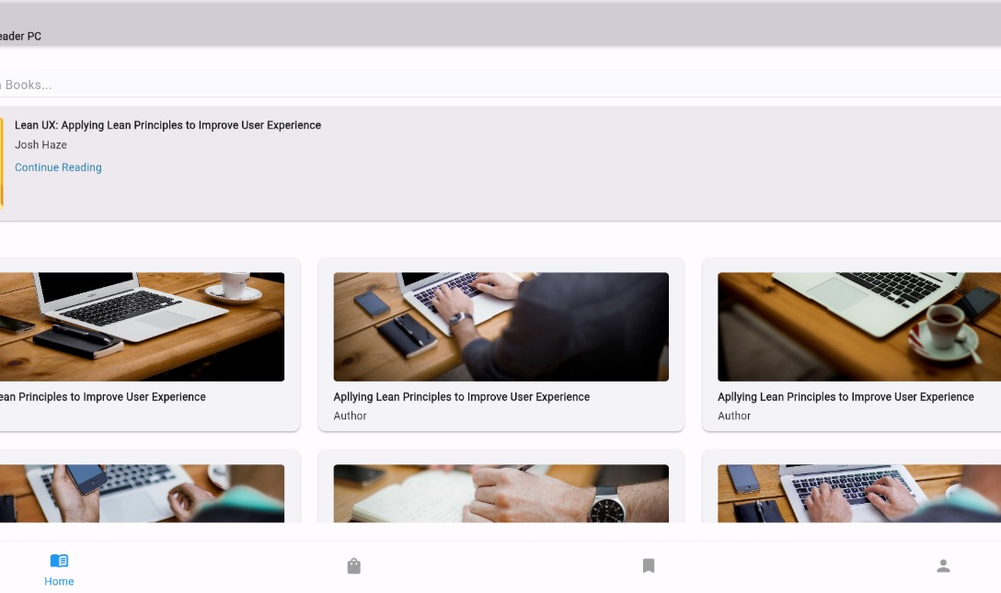
Reading Features
Customizable Reading Features
The app offered adjustable font sizes, night mode for low light conditions, and bookmarking for easy navigation within the text. These features aimed to enhance the user's reading experience and personalized library organization.
Photos provided by Unsplash

Slide 5

Challenges Faced
Development Challenges
The integration complexity with ebook libraries, performance optimization for handling large ebook files, and maintaining cross-platform compatibility presented significant challenges during the development process. Addressing these challenges required thorough optimization techniques and platform-specific testing and tweaking.
Photos provided by Unsplash

Slide 6

Future Enhancements
Cloud Sync and Annotation
Audio Book Support and Social Features
Future enhancements for the app include implementing cloud synchronization to allow users seamless access to their library and reading progress across multiple devices. Additionally, advanced annotation features for highlighting, note-taking, and sharing excerpts can be integrated to further enhance the reading experience.
The app's potential future enhancements also encompass integrating support for audio books with playback controls, synchronization with the text, and incorporating social features such as book clubs, recommendations, and discussion forums to engage users and create a sense of community.
Photos provided by Unsplash

Slide 7

Conclusion
Catering to Diverse Reading Needs
In conclusion, the development of the Flutter e-reader app aimed to provide a seamless and personalized reading experience, catering to the diverse needs of readers in the digital age. The app's effective state management and integration with ebook libraries position it to become a comprehensive platform for book enthusiasts worldwide, with potential future enhancements further enhancing its impact.
Photos provided by Unsplash

Slide 8
